Slide 1
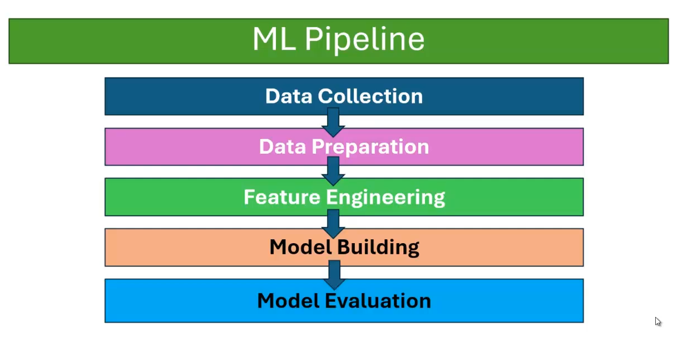

Slide 2
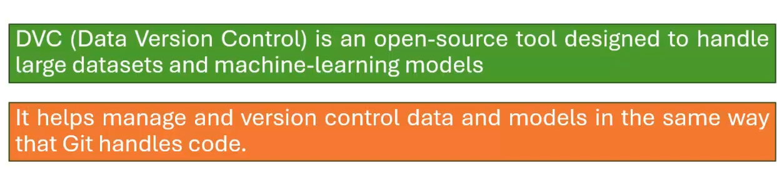
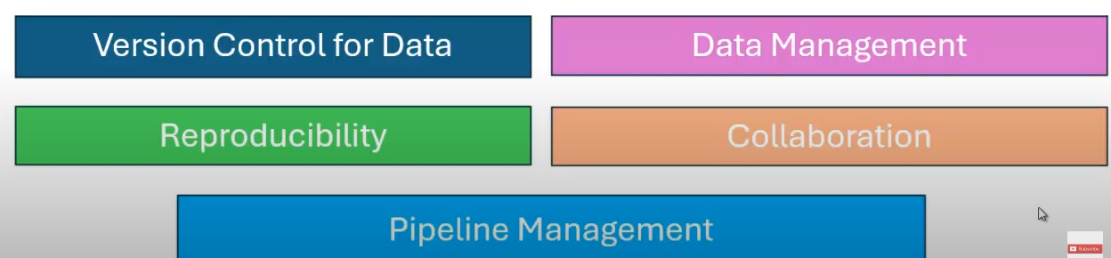

Slide 3
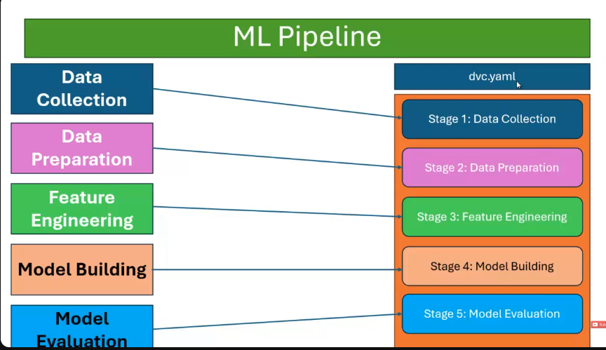
Preparing a DVC Pipeline
To execute the Pipeline

Slide 4
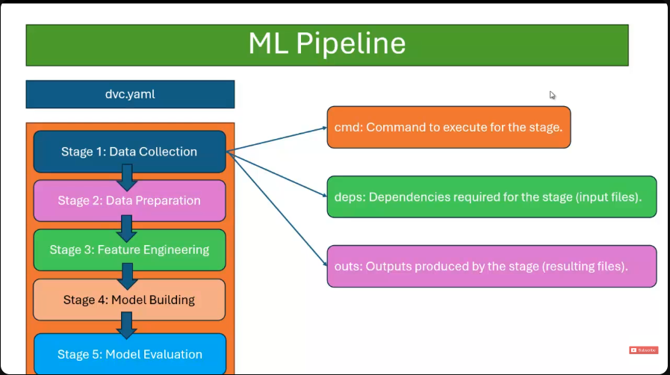
Each Stage has
3 main parts

Slide 5
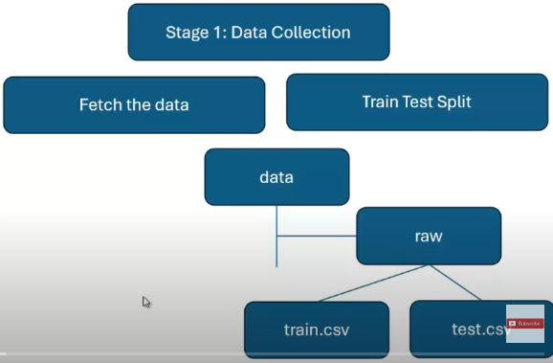

Slide 6
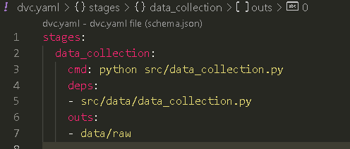
Add step 1 to dvc.yaml pipelie
Terminal command
dvc.yaml pipeline added the first stage of data_collection

Slide 7

Use the dvc repro command to
run the dvc.yaml pipeline

Slide 8
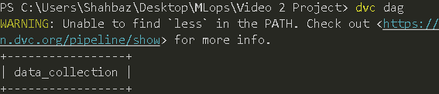
Use dvc dag to display all the
Stages in dvc.yaml pipeline

Slide 9
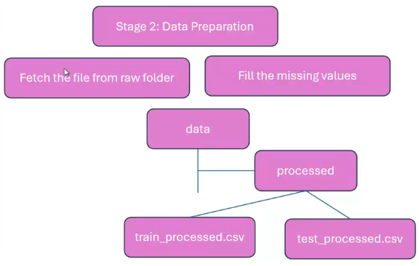

Slide 10
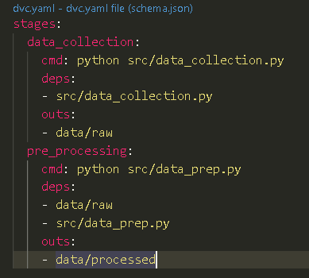
Add step 2 to dvc.yaml pipelie
Terminal command
dvc.yaml pipeline added the second stage of data_prep

Slide 11
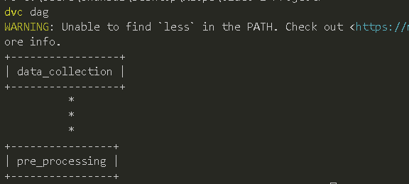
Use dvc dag to display all the
Stages in dvc.yaml pipeline

Slide 12
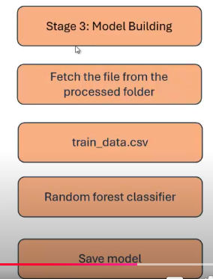

Slide 13
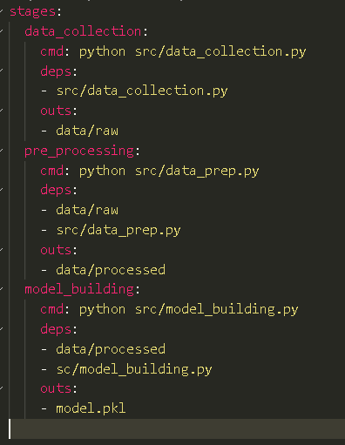
Add step 3 to dvc.yaml pipelie
dvc.yaml pipeline added the third stage of model_building

Slide 14
Stage 4: Model Evaluation

Slide 15
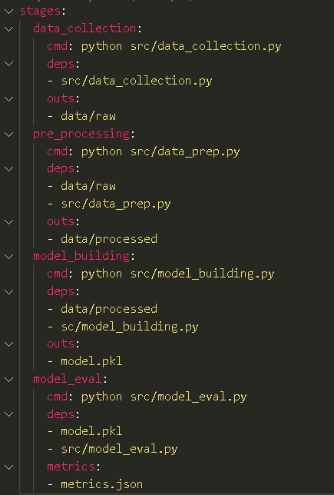
Add step 4 to dvc.yaml pipelie
dvc.yaml pipeline added the fourth stage of model_eval

Slide 16
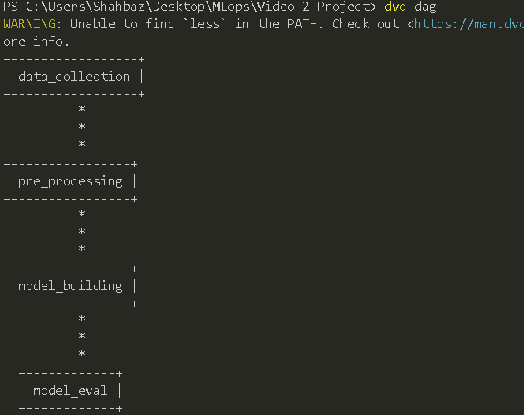
Use dvc dag to display all the
Stages in dvc.yaml pipeline

Slide 17

Use dvc metrics show to display
all the accuracies

